Slide 1
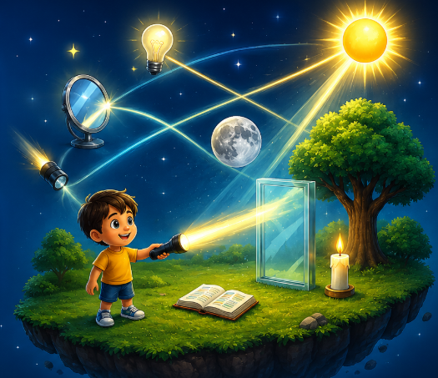


Let's explore the fascinating world of light!
Light and Its Properties
Reflection of Light and Laws of Reflection
Choose a topic to begin.

Slide 2
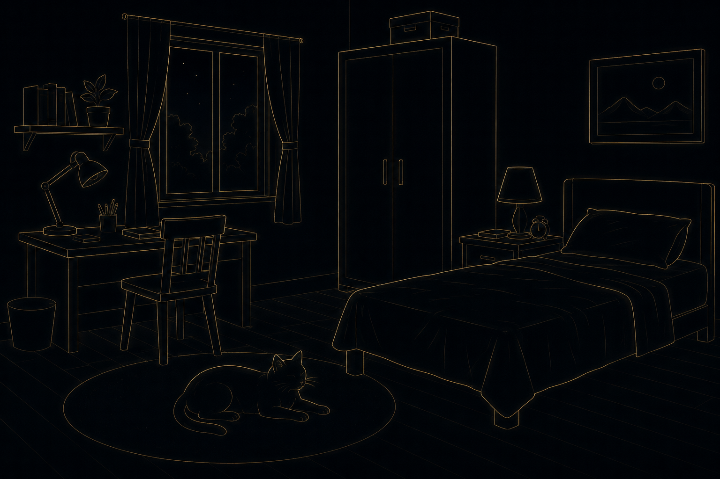
Can you find the cat in the dark?
Create a dark room where all objects are visible only as faint silhouettes so that students cannot clearly identify them. let students tap the cat if they think they found it. If they tap anywhere ,move to next slide automatically
Look carefully and tap where you think the cat is.

Slide 3
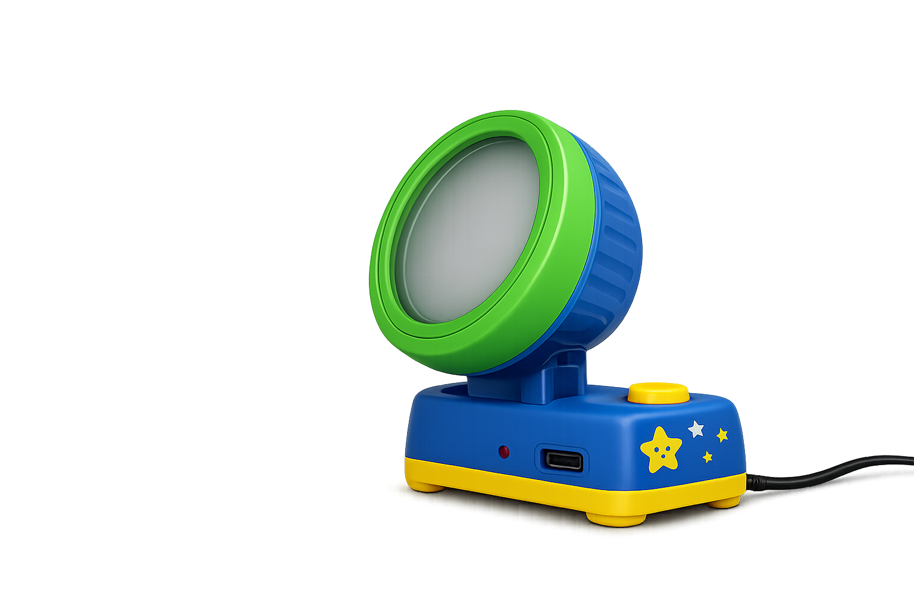
It is difficult to see in the dark. What happens when light is switched on?
Place a flashlight at the bottom of the screen and make it the primary interactive element and pulsate it.. When the student taps the flashlight, animate a beam of light spreading across the room while gradually increasing the room's brightness over approximately half a second. As the room becomes brighter, smoothly reveal all hidden objects.
Tap the flashlight to light up the room.

Slide 4
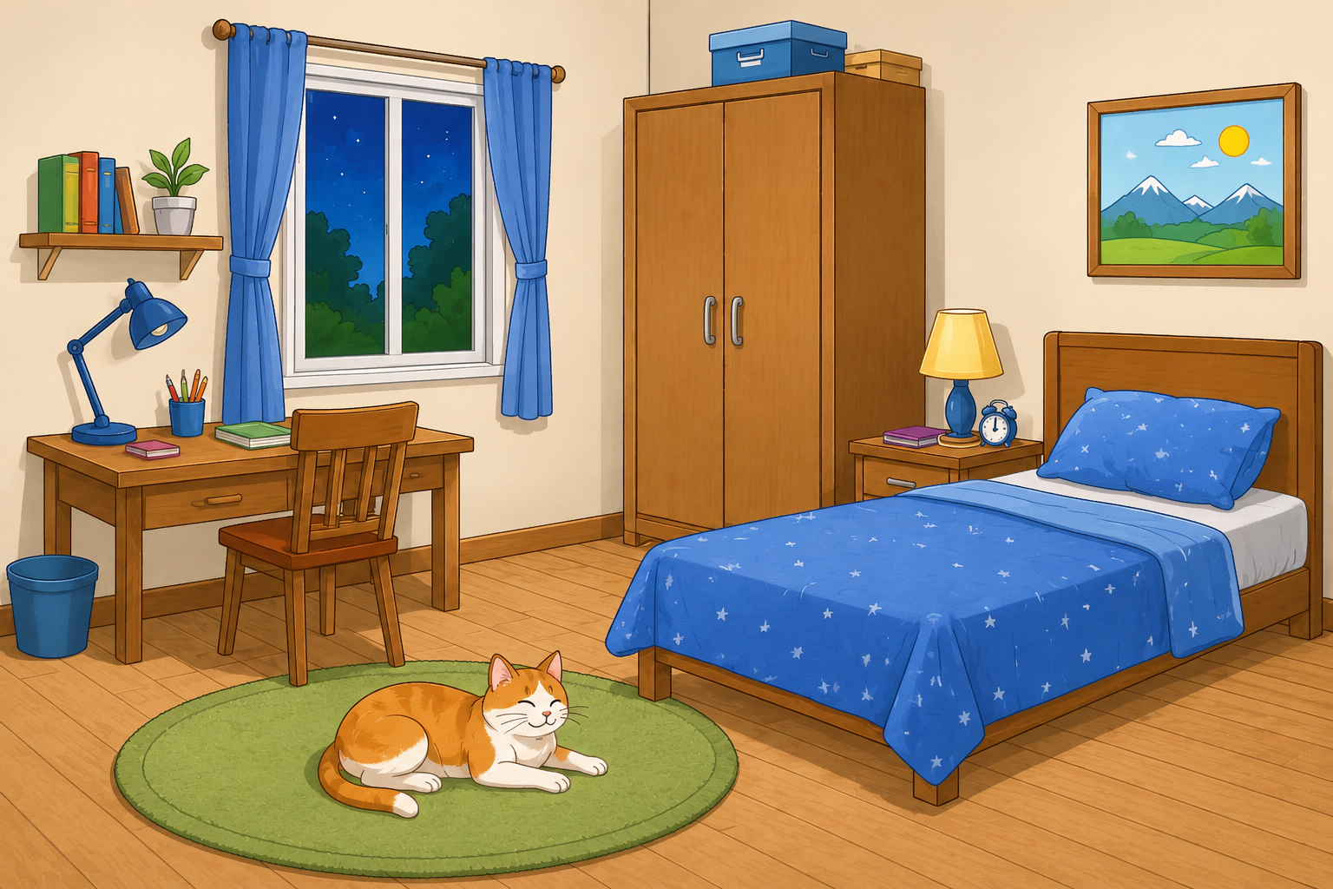
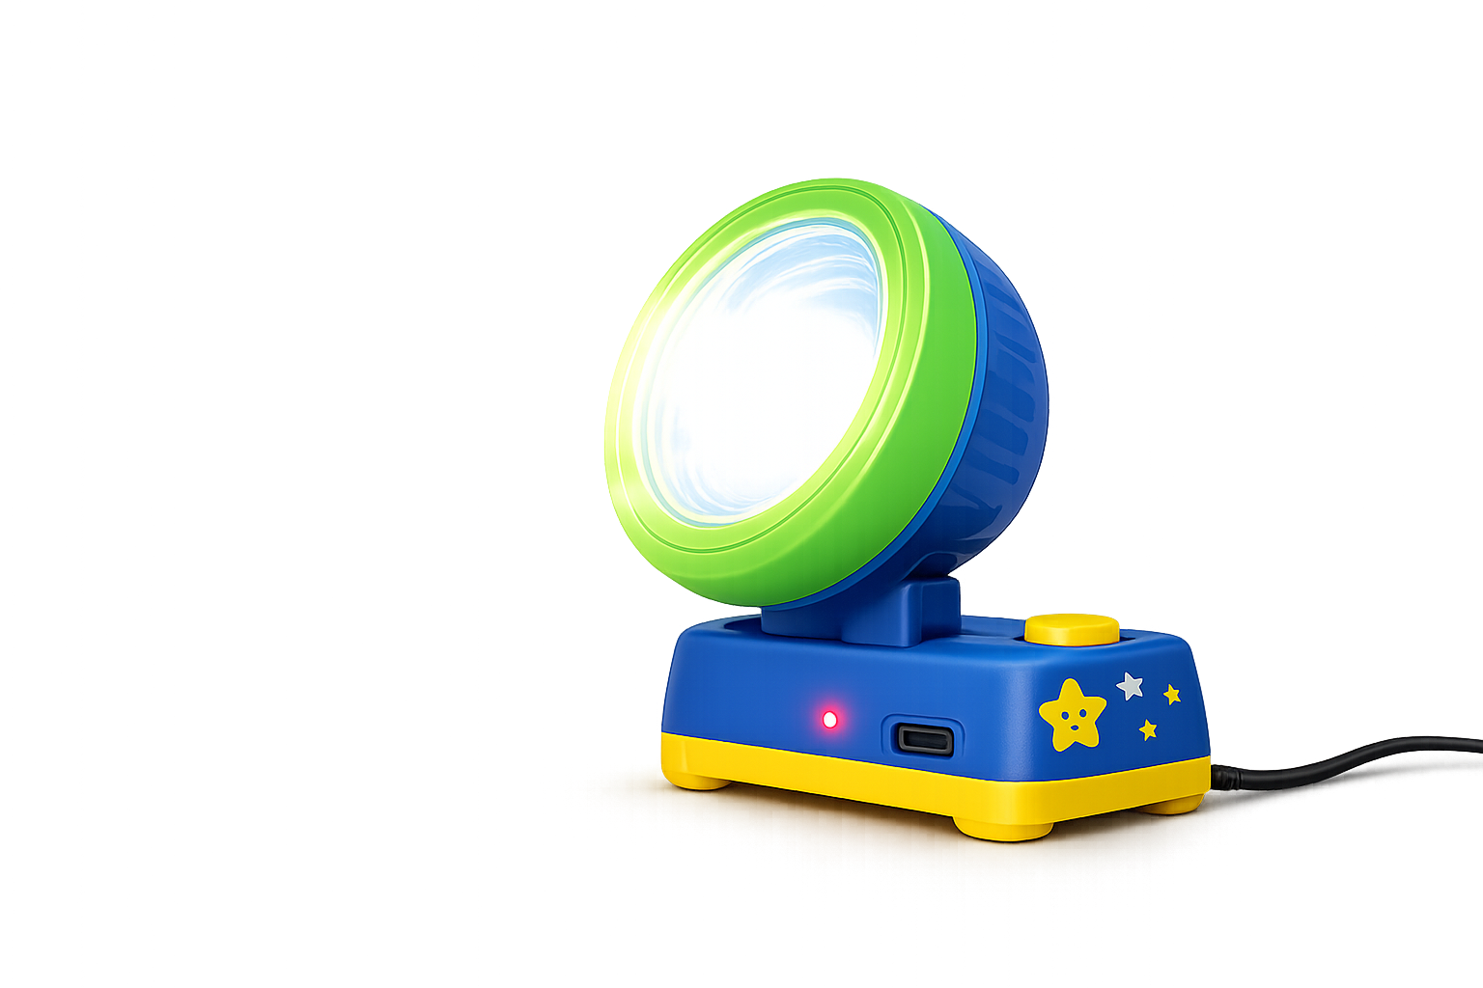
What helped you see the cat?
Air
Light
Sound
Choose the correct answer.

Slide 5
What helped you see the cat?
Air
Light
Sound
Good try! Watch what happens when the flashlight turns OFF and ON again. What makes the room bright?
When the user select the incorrect option, The flashlight automatically turns OFF.The room becomes dark. The cat disappears. Then the flashlight turns ON again.The cat becomes visible. And then display the feedback
Choose the correct answer.

Slide 6
Light is a form of energy that helps us see the objects around us.
Air
Light
Sound
Provide on and off button for flashlight.
Excellent! Without light, we cannot see the objects around us.
Allow the flashlight to be switched on and off repeatedly so students can observe that objects become visible only when light is present.
Switch the flashlight ON and OFF. Observe how the objects appear and disappear. .

Slide 7
Brighter light makes objects easier to see.
Instead of only
Dark
Dim
Bright
show
30%
60%
100%
and gradually reveal details
Bright
Dim
Dark
Add a brightness slider that lets students adjust the intensity of the flashlight. As the slider moves, gradually increase or decrease the brightness of the room and the visibility of the objects.
Move the slider to see how brightness affects visibility.

Slide 8
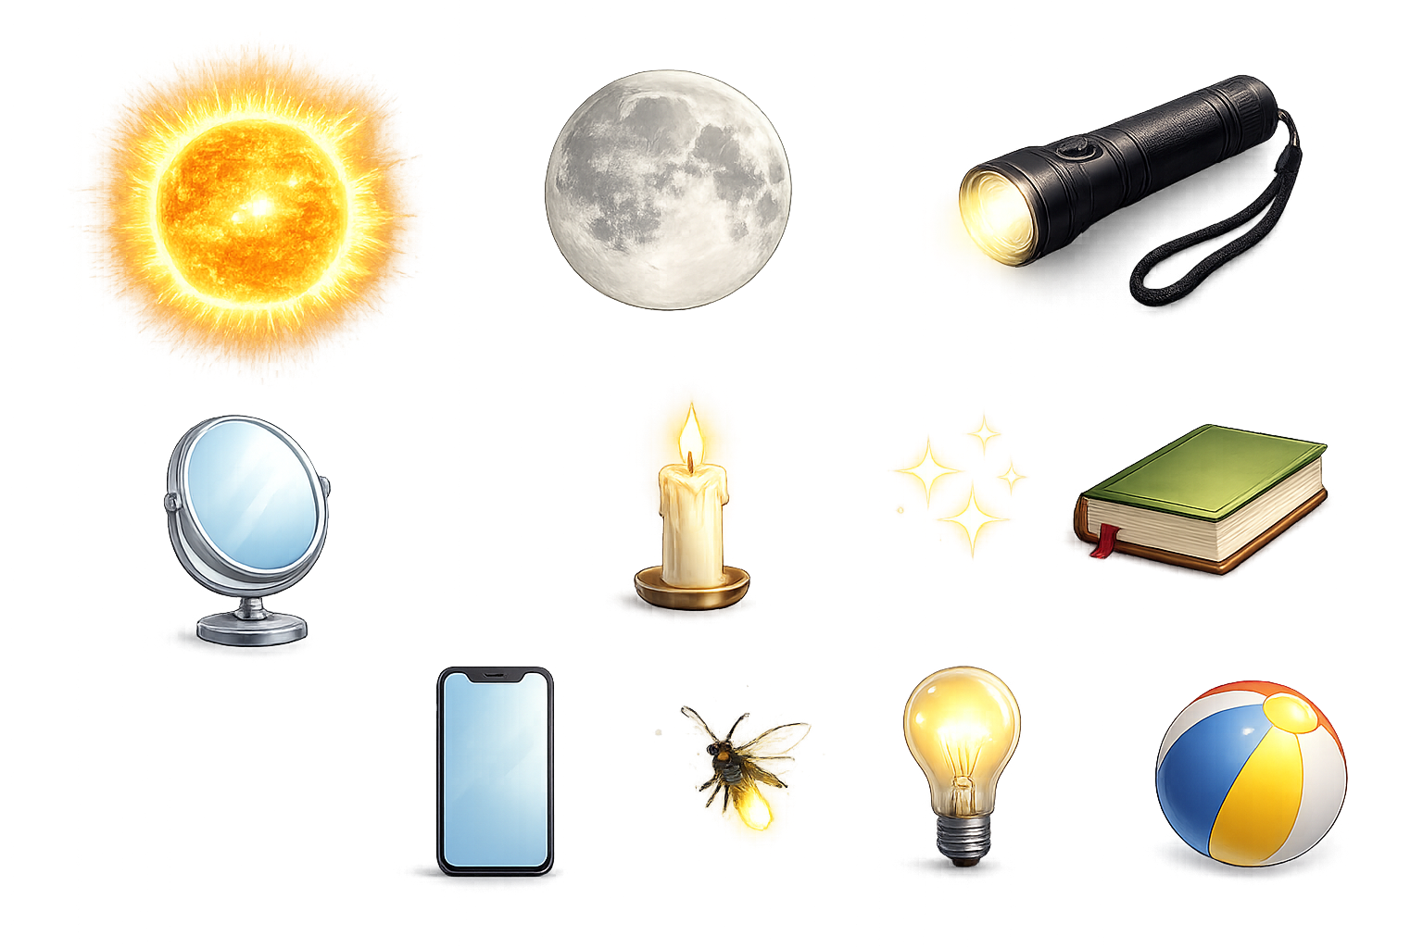


Some objects produce their own light. Others do not. Let's find out which is which.
Produces Light
Does Not Produce Light
Arrange the objects properly. Allow students to drag each object into one of the baskets and provide instant visual feedback after every placement.
If an object is placed correctly, play a short success animation and lock it into the basket. If placed incorrectly, gently return it to its original position.
Allow students to tap any object to observe its behavior. When a Luminous Object is Tapped
Example: Torch
Switch ON.
Emit light.
Soft glow animation.
Feedback:
This object produces its own light.
When a Non-Luminous Object is Tapped
Example: Book
Nothing glows.
Feedback:
This object does not produce its own light.
Drag each object into the correct basket. Tap an object to see if it produces light.

Slide 9
Some objects produce their own light. Others do not. Let's find out which is which.
Produces Light
Does Not Produce Light
Objects that produce their own light are called luminous objects.
Objects that do not produce their own light are called non-luminous objects.
Tap next to explore the light more.

Slide 10
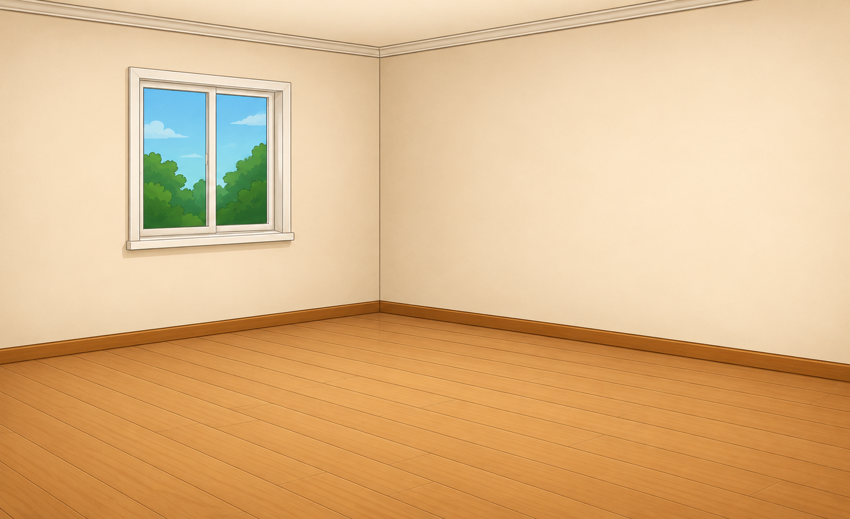
Let's explore the properties of light.
When the student turns on the flashlight, animate a bright light beam travelling in a straight line from the flashlight to the wall. The beam should appear instantly and remain visible until the flashlight is switched off.
Reference video link :Link
Tap the flashlight and observe the path of the light.

Slide 11
Can you make the light bend around the corner?
1. Light always travels in a straight line.
Create a simple maze with a flashlight at one end and a target at the other.
Allow students to rotate the flashlight but ensure that the light beam always travels in a straight line and cannot bend around corners, after 2 rotations,reveal “ 1. Light travels in straight line.”
Rotate the flashlight and try to make the light reach around the corner.

Slide 12
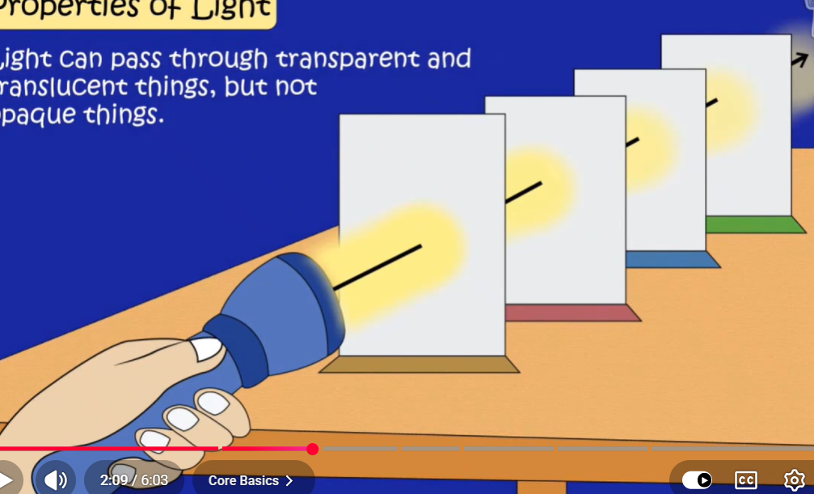

Can light pass through this material?
1. Light always travels in a straight line.
After two seconds of straight line drawing and displaying the property, make two locations on the light beam to place the sheet of paper (location should be place with paper sheet already with less opacity indicating that the sheet should be dragged to those places) Allow students to drag the cardboard anywhere between the flashlight and the wall and automatically update the light passes through the transparent object.
Place the transparent sheet in the light beam and observe what happens.

Slide 13
Light passes through transparent materials and continues to travel in a straight line.
1. Light always travels in a straight line.
2. Light passes through transparent materials.
Visuals should look like in the reference image Link
Light travels through transparent objects.
After two seconds of straight line drawing and displaying the property, make two locations on the light beam to place the sheet of paper (location should be place with paper sheet already with less opacity indicating that the sheet should be dragged to those places) Allow students to drag the cardboard anywhere between the flashlight and the wall and automatically update the light passes through the transparent object.
Tap next to see what happens when light meets an opaque object.

Slide 14
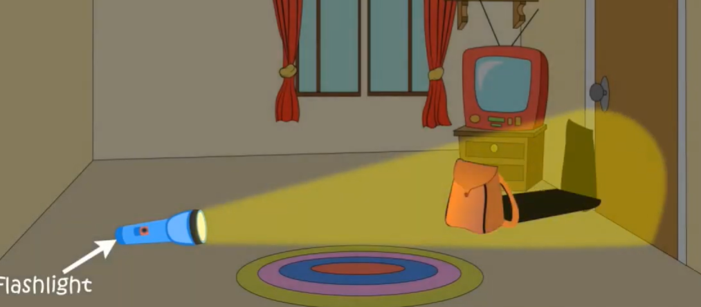
What about the cardboard ? Will it block the light completely?
1. Light always travels in a straight line.
2. Light can pass through transparent materials.
Allow students to drag the cardboard anywhere between the flashlight and the wall and automatically update the shadow position and size based on its location.Please check the reference image
Place the cardboard in the path of the light and observe what happens.

Slide 15
Light travels in a straight line. Opaque objects block light and create shadows.
1. Light always travels in a straight line.
2. Light passes through transparent materials.
3. A shadow is formed when an opaque object blocks the path of light.
Kindly check the reference for the shadow to be formed. Allow the user to drag the cardboard and observe the size of the shadow.
Allow students to drag the cardboard anywhere between the flashlight and the wall and automatically update the shadow position and size based on its location.Please check the reference image
Drag the cardboard sheet along the light path and observe the size of the shadow.

Slide 16
Let's review what we have discovered about light.
1. Light always travels in a straight line.
2. Light passes through transparent materials.
3. A shadow is formed when an opaque object blocks the path of light.
Tap next to explore the properties of light with more object.

Slide 17
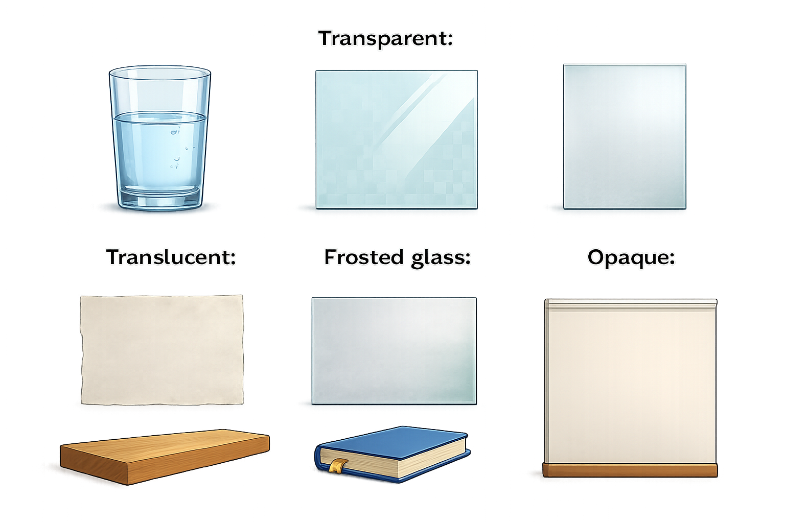
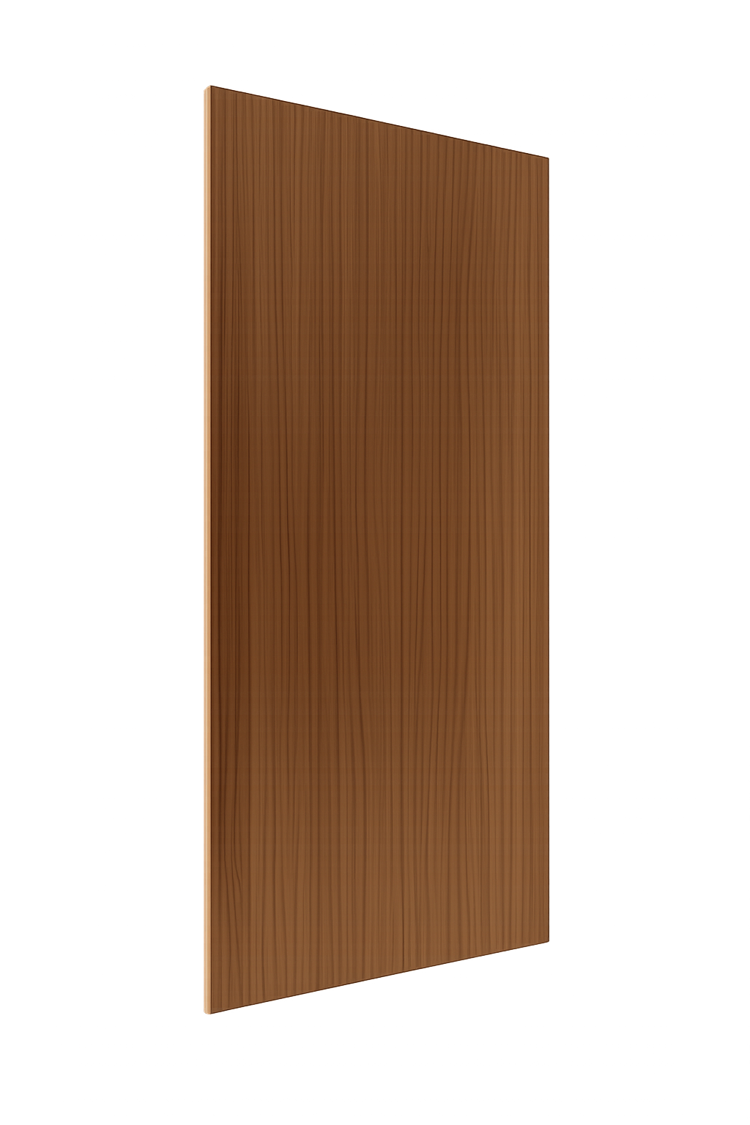
Which material lets the most light pass?
Pulsate the area to place the objects.
display three materials: clear glass, butter paper, and a wooden board.
Allow students to place each material in front of the flashlight and observe how much light passes through it.
Place each material in the light beam and compare how much light passes through it.

Slide 18
Which material lets the most light pass?
Glass – Light passes. —Transparent
Butter paper - Some light. –Translucent
Wood - No light. — Opaque
Transparent object
Light passes through transparent materials, passes partly through translucent materials, and does not pass through opaque materials.
Place each material in the light beam and compare how much light passes through it.

Slide 19
Let's explore the fascinating world of light!
Light and Its Properties
Reflection of Light and Laws of Reflection
Choose a topic to begin.

Slide 20
Can you find the cat in the dark?
Create a dark room where all objects are visible only as faint silhouettes so that students cannot clearly identify them. let students tap the cat if they think they found it. If they tap anywhere ,move to next slide automatically
Look carefully and tap where you think the cat is.

